Slide 1



2023
PHAU NTAWV QHIA TXOG COV TXIAJ NTSIM KEV PAB
October 3 – October 31, 2022

Slide 2

AGENDA
Welcome
Changes for 2023
Eligibility
2023 Benefits Overview
Enrollment Process
How to Enroll
Questions

Slide 3

Changes for 2023
New medical plan carrier - Centivo
Increased dental coverage for annual maximums
New Life, Disability, Accident, and Critical Illness carrier
Enhanced Critical Illness and Accident Benefit

Slide 4

Kev Tsim Nyog Tau Kev Pab
Who can enroll?
Employees working at least 30 hours/week
Legal spouse
Children under the age of 26
Disabled dependent children
When can you enroll?
During Annual Open Enrollment
Within 31 days of a Qualifying Event
New Hires: Within 31 days of your date of hire

Slide 5
Kev Kho Mob

Slide 6


Medical plan - centivo
A new type of health plan for Masters Gallery employees:
Designed to offer you affordable healthcare and the resources to use healthcare more effectively
Built around a partnership between you and your personally selected Primary Care Provider (PCP)

Slide 7

Medical plan - centivo
If you work with your Primary Care Provider to manage your health, you’ll get:
Affordable care with:
No deductible (if the No-deductible plan is chosen)
FREE primary care visits
Simple, predictable copays for all other care
Urgent care covered at in-network rates when you are away from home
Emergency care covered at in-network rates no matter where you are
A convenient virtual care primary care option (Tele-Med)
Visit the network directory site at mastersgalleryfoods.centivo.com to search for doctors or facilities by type, name or zip code

Slide 8
Medical Plan Comparison
Key Medical Benefits | Centivo No-Deductible Network |  | Centivo Choice Network
 | In-Network | Out-of-Network | In-Network | Out-of-Network
Deductible (Individual/Family) | $0 / $0 | N/A / N/A | $3,000 / $6,000 | $6,000 / $12,000
Out-of-Pocket Maximum (Individual/Family) | $4,000 / $8,000 | N/A / N/A | $6,500 / $13,000 | $10,000 / $20,000
Covered Services
Office Visit (Physician/Specialist) | No charge / $100 copay | N/A | No charge / $100 copay | 50%*
Routine Preventive Care | No charge | N/A | No charge | 50%*
Outpatient Diagnostic Lab/X-ray | $20 copay | N/A | $20 copay | 50%*
Outpatient Surgery | $700 copay | N/A | 30%* | 50%*
Inpatient Hospital Stay | $900 copay | N/A | 30%* | 50%*
Emergency Room | $350 copay | $350 copay | $300 copay + 30%* | $300 copay + 30%*
Urgent Care Facility | $100 copay | N/A | $100 copay | 50%*
Prescription Drugs (Generic / Preferred / Non-Preferred)
Retail Pharmacy (30-day supply) | $10 / 20% / 30% | N/A | $15 / 20% / 30% | N/A
Retail Pharmacy (90-day supply) | $30 / 20% / 35% | N/A | $45 / 20% / 35% | N/A
Mail Order (90-day supply) | $25 / 20% / 35% | N/A | $37.50 / 20% / 35% | N/A
Specialty (Navitus) | 20% | N/A | 20% | N/A
Coinsurance percentages and copay amounts shown in the above chart represent what the member is responsible for paying.
*Benefits with an asterisk ( * ) require that the deductible be met before the Plan begins to pay.

Slide 9
Centivo – no deductible plan
Plan Features:
Slightly smaller network of providers
No deductible
Set copay amounts
FREE visits with your designated Primary Care Provider Team
Virtual Primary Care options (TeleMed)
Coordination of Care between your Primary Care Team and Specialists
Emergency Care covered as in-network no matter where you are
Notes:
The No Deductible Plan has a slightly smaller network but there is no deductible, so coverage starts right away. Features include:
No deductible
Set copays so you always know what you’ll owe before you get care
FREE visits with your designated in-network Primary Care Team
Centivo Virtual Primary Care, a convenient no-cost alternative to in-person primary care that you can access anywhere from your phone or computer
A Primary Care Team who will coordinate your care and refer you to local, trusted specialists
Urgent care covered at in-network rates when you’re away from home
Emergency care covered at in-network rates no matter where you are

Slide 10
Centivo – choice network plan
Plan Features:
Broader network of providers
Set copay amounts
FREE visits with your designated Primary Care Provider Team
Virtual Primary Care options (TeleMed)
Coordination of Care between your Primary Care Team and Specialists
Emergency Care covered as in-network no matter where you are
Notes:
The Choice Network Plan has a deductible, so you’ll have to pay out-of-pocket before your plan will cover your care. This plan has a broader network but will cost more. Features include:
Set copays so you always know what you’ll owe before you get care
FREE visits with your designated in-network Primary Care Team
Centivo Virtual Primary Care, a convenient no-cost alternative to in-person primary care that you can access anywhere from your phone or computer
A Primary Care Team who will coordinate your care and refer you to local, trusted specialists
Urgent care covered at in-network rates when you’re away from home
Emergency care covered at in-network rates no matter where you are

Slide 11
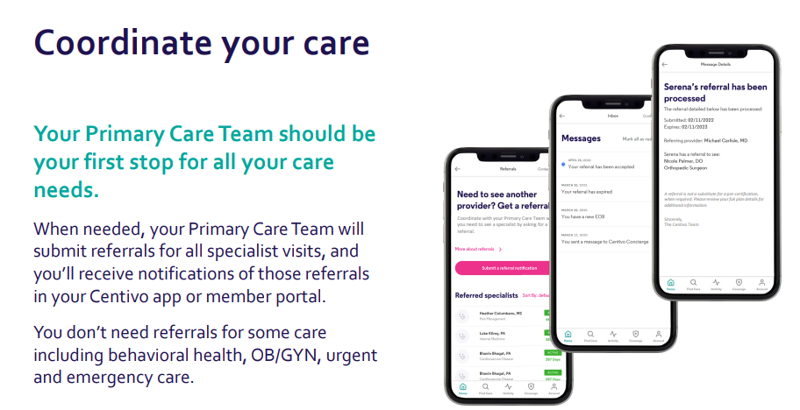
Medical plan – pcp activation
Services which do not require a referral include:
Urgent Care
Emergency Medical Care
OB/GYN Care
Behavioral Health Care
Physical, Occupational and Speech Therapy
Chiropractic Care
Alternative Medicine Care
Labs, X-Rays and Other Covered Tests
Services available at the Center for Health and Wellness

Slide 12
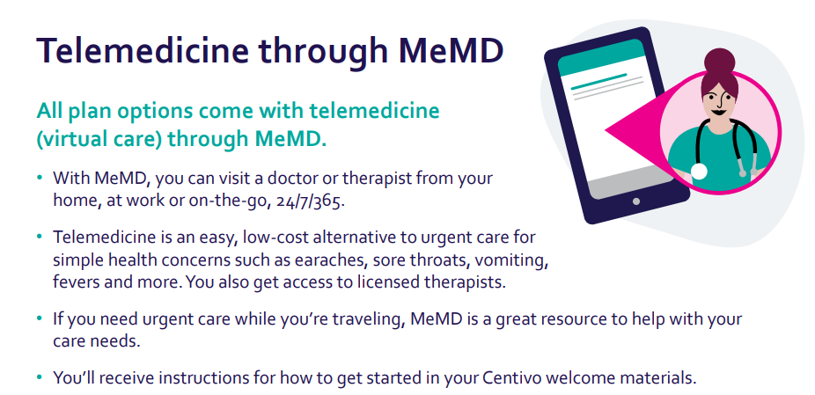
Medical plan – telemedicine

Slide 13
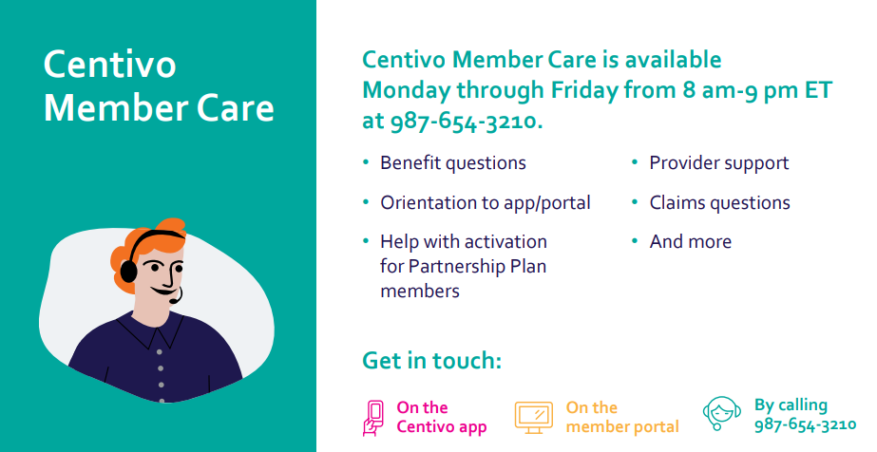
Medical plan – member care

Slide 14
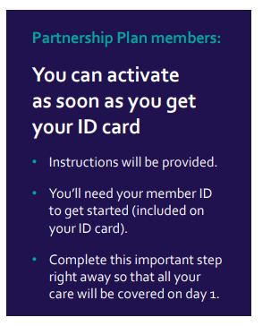



Medical plan – member care
Getting Started with Your Health Plan
You’ll receive your medical plan ID card at the end of December. If you need to get care before you receive it, call the Centivo Member Care Team for help
Employees who enroll in the Centivo Plan will receive instructions to “Activate” in order to ensure coverage on Day 1
For any questions on your health plan during the year, you can always call the Centivo Member Care Team

Slide 15
Pharmacy coverage

Slide 16

Pharmacy
Mail-Order Pharmacy
Mobile App
Register & Get Started (New enrollees only)
Visit www.serve-you-rx.com
Print New Prescription Mail-Order Form
Contact Customer Service at 800-481-4940
Provide your current pharmacy’s phone number and you prescription number
Fax a new prescription to 866-494-0364
Enjoy greater convenience at your fingertips
With the mobile app you can:
• Compare medication prices to find the lowest cost option for you
• Locate the most convenient network pharmacies
• Save your preferred pharmacies for quick and easy access
• Save your medication information
• View your member ID card
• The mobile app features easy registration, simple navigation, and an innovative, user-friendly design to help you navigate your prescription benefits. Plus, you'll gain access to all of the helpful information you need to make informed decisions about your prescriptions and continue on the path to improved health.

Slide 17
Pharmacy
Specialty Pharmacy
Patient Care Coordinators, Nurses & Pharmacists
Toll-free assistance: 866-333-2757
Prescriber Support
Single contact for specialty medications
Reporting
Clinical Services
Education on both condition and medication
Drug therapy monitoring
Side-effect and adverse event management
Injection training over the phone
Monthly refill and education calls

Slide 18
Hniav

Slide 19

DENTAL Plan highlights
Key Dental Benefits | Delta Dental DPPO
 | In-Network | Out-of-Network
Deductible (Individual/Family) | $50 / $150 | $50 / $150
Benefit Maximum (per Individual) | $2,000 | $2,000
Covered Services
Preventive Services (List Services) | No charge | No charge
Basic Services (List Services) | 20%* | 20%*
Major Services (List Services) | 50%* | 50%*
Orthodontia (Children up to age 19) | $2,000 lifetime maximum benefit | $2,000 lifetime maximum benefit
Increased maximums for Dental and Orthodontia coverage!
Coinsurance percentages and copay amounts shown in the above chart represent what the member is responsible for paying.
*Benefits with an asterisk ( * ) require that the deductible be met before the Plan begins to pay.

Slide 20
Qhov Muag Pom Kev

Slide 21


VISION Plan Highlights
Key Vision Benefits | EyeMed Vision
 | In-Network Only | Out-of-Network
Exam (once every 12 months) | $10 | Up to $35
Materials Copay | $10 | N/A
Lenses (once every 12 months)
Single Vision | $10 | Up to $25
Bifocal | $10 | Up to $40
Trifocal | $10 | Up to $55
Frames (once every 24 months) | Covered up to $130 | Up to $65
Contact Lenses (once every 12 months; instead of prescription glasses) | Covered up to $120; 15% off balance | Up to $96

Slide 22
Flexible Spending Accounts (Cov As Khauj Siv Nyiaj Yooj Yim)

Slide 23

Flexible Spending Accounts (Cov As Khauj Siv Nyiaj Yooj Yim)
Administered by EBC (Employee Benefits Corporation)
Debit card for easy access to health care funds
Plan Year ends on December 31 or upon your termination of employment, whichever is earlier
Claims must be submitted no later than 90 days after the Plan Year ends
Any amount over $570* left in the account at year-end is forfeited
*Current IRS limit for 2023 will apply

Slide 24
Flexible Spending Accounts (Cov As Khauj Siv Nyiaj Yooj Yim)
FSA Rau Kev Kho Kab Mob Kev Nkeeg (HCFSA)
FSA Rau Kev Zov Me Nyuam (DCFSA)
Out-of-pocket healthcare expenses such as copays, deductibles, coinsurance, dental and vision expenses
Maximum tax year election is $2,850*
Up to $570* can carryover into 2024
*Current IRS limit for 2023 will apply
Pay for eligible daycare expenses for children up to age 13 or adult dependents who are disabled
Maximum tax year election is $5,000 maximum per household ($2,500 max per person if married or filing separately)

Slide 25
Kev Pov Hwm Txoj Sia thiab AD&D

Slide 26


Basic Life/AD&D (Lag luam them rau)
100% paid by Masters Gallery Foods
Mutual of Omaha is the new benefit carrier
Benefit
Amount | 1 times base salary
Benefit Maximum | $50,000
AD&D | Provides additional benefit should you die, lose a limb, or hearing as a result of an accident

Slide 27
Supplemental Life / AD&D (Neeg ua hauj lwm them rau)
Option to purchase additional life insurance for self and family members
Mutual of Omaha is the new benefit carrier
Remember: True Open Enrollment – This is your one-time opportunity to elect or increase Supplemental Life Insurance
Benefit Options
Amount | Employee: $25,000 increments up to $200,000 maximum Spouse: $5,000 increments up to $50,000 maximum Child: Under age 26 – up to $10,000 (Spouse and Child only eligible for coverage if employee is also covered)
Guarantee Issue | Employee: $200,000 ($100K increase from previous coverage) Spouse: $50,000 Child: $10,000
Notes:
You have the option to purchase additional life insurance for yourself and family members

Slide 28
Kev Pov Hwm Pab Txoj Kev Tsis Taus

Slide 29
Kev Pov Hwm Pab Txoj Kev Tsis Taus
Kev Tsis Taus Mus Ntev
Siab Yeem Txoj Kev Tsis Taus Ib Ntus
100% paid by Masters Gallery
Mutual of Omaha is the new benefit carrier
100% paid by you
Mutual of Omaha is the new benefit carrier
Plan Highlights
Benefit Percentage | 50%
Monthly Benefit Maximum | $5,000
When Benefits Begin | After 90 days of qualified non-work-related disability
Maximum Benefit Duration | 5 years
Plan Highlights
Benefit Percentage | 60%
Weekly Benefit Maximum | $1,500
When Benefits Begin | After 14th day of qualified non-work-related disability
Maximum Benefit Duration | 11 weeks
Contact your Human Resources Department for all medical leave questions
Notes:
Disability insurance provides benefits that replace part of your lost income when you are unable to work due to a covered injury or illness.

Slide 30
Cov Txiaj Ntsim Kev Pab Siab Yeem

Slide 31
Cov Txiaj Ntsim Kev Pab Siab Yeem
Kev Pov Hwm Raug Mob Yuam Kev
Kev Muaj Mob Nyhav
Accident Insurance can soften the financial impact of an accidental injury by paying a benefit to you to help cover the unexpected out-of-pocket costs related to treating you or your covered family member’s injuries
100% paid by you
Mutual of Omaha is the new benefit carrier
With Critical Illness insurance, you’ll receive a lump-sum benefit if you are diagnosed with a covered condition that you can use however you would like, including to help pay for: treatment, prescriptions, travel, increased living expenses and more.
100% paid by you
Mutual of Omaha is the new benefit carrier
Both coverages offer a Wellness Incentive of $100 per covered member per year!
This benefit can allow the plan to pay for itself!
Notes:
Benefits are designed to complement your health care coverage. Coverage also available for your spouse and dependents.
Accident Insurance
Accident insurance can soften the financial impact of an accidental injury by paying a benefit to you to help cover the unexpected out-of-pocket costs related to treating your injuries.
Critical Illness
Did you know that the average total out-of-pocket cost related to treating a critical illness is over $7,000¹? With critical illness insurance, you’ll receive a lump-sum benefit if you are diagnosed with a covered condition that you can use however you would like, including to help pay for: treatment (e.g. experimental), prescriptions, travel, increased living expenses, and more.
Wellness Benefits
Critical illness and accident coverage offers a wellness incentive of $100 per covered member per year when a wellness screening occurs. Example: Over the course of the year, ff both the employee and spouse have a wellness screening and submit the wellness benefit form they will receive a check for $200 (or $100 each).

Slide 32
Employee Assistance Program (Txoj Kev Pab Txhawb Neeg Ua Hauj Lwm) (EAP)

Slide 33
Employee assistance program (Txoj Kev Pab Txhawb Neeg Ua Hauj Lwm) (EAP)
100% paid by Masters Gallery
Mutual of Omaha is the new benefit carrier
Up to three (3) sessions per issue per year
Unlimited 24/7 access to counselors – CONFIDENTIAL!
Over the phone
In person
Personal, legal and financial assistance
Online tools, tutorials, videos and much more!
More information will be posted, emailed, and available via MyMGF and UKG in January

Slide 34
Cov Muaj Nqis Ntxiv

Slide 35

Valuable Extra Benefits
OneAmerica 401K
Center for Health and Wellness – Near-Site Wellness Centers
AAA Coverage

Slide 36
Rates / contributions

Slide 37
Benefit Costs (Bi-weekly)
Payroll Deductions | Employee Only |  | Employee + Spouse |  | Employee + Child(ren) |  | Employee + Family
 | Standard | Well Worker | Standard | Well Worker | Standard | Well Worker | Standard | Well Worker
No Deductible Medical Plan | $99 | $69 | $202 | $143 | $163 | $114 | $288 | $210
Choice Plan | $84 | $58 | $174 | $123 | $140 | $99 | $247 | $180
Smoking Surcharge | $10 |  | $20 ($10 EE / $10 SP) |  | $10 |  | $20 ($10 EE / $10 SP)
Dental Plan | $3 |  | $6 |  | $8 |  | $10
Vision Plan | $3.89 |  | $7.78 |  | $7.94 |  | $11.83
Please refer to the Benefit Guide for a full breakdown of Life, Disability, Accident, and Critical Illness rates.

Slide 38
Well worker information
Who must participate to receive discount?
All Employees and their spouses (if covered under the Medical Plan).
How to Participate?
Well Worker premiums will be honored and continue for all employees and spouses who qualified in 2022 or upon hire. Employees who are currently paying the higher premium can complete a Well Worker exam for 2023 by December 15, 2022 to qualify for Well Worker 2023 premiums. Previous annual exam within last 6 months can be used.
Where can I have my Preventative / Wellness Exam completed?
Any Physician of your choice, including the Center for Health and Wellness (does not need to be your primary care provider). Please note: If you do not participate in the Well Worker Program it is not possible to prove smoker status and you will automatically be charged the higher smoker rates

Slide 39
Enrollment process

Slide 40



How to enroll
Go to www.nw16.ultipro.com*
For a paper copy, contact Katie Boge
Deadline is october 31, 2022
* Additional Benefits Information, including Summary Plan Descriptions (SPDs) and Compliance Notices*, are available on the Masters Gallery Foods, Inc., UKG homepage / Myself / My Company / Electronic Forms
Notes:
Go to nw16.ultipro. com* For detailed information about the plans available to you and instructions for enrolling.
If you would like a paper copy of any of the documents available on UKG, contact Katie Boge

Slide 41

Questions

